Slide 1
Judging School Costa Mesa, CA
February 18, 2023

Slide 2
Guidelines
Based on the 2019 Dallas Judging Retreat, and recent presentations
Using the Judging Reference Manual
Using established NCRS criteria
Attempting to equalize judging
Any judge should be able to obtain the same result

Slide 3
Goals
Provide an objective decision-making process
Provide specific requirements
Provide specific guidelines
Ensure more repeatability.
Every judge has the same conclusion.
A car would receive the same score regardless of the judge(s)

Slide 4
For Owners
Know how to operate your car
Heater
Lights
Radio
White sheet to put all your items on
Spare, ignition shield, air cleaner, trunk tools
Put everything on the sheet
3 ring binder for the seat separator items
Clear sleeve for each item
Judging keys go in the ignition

Slide 5
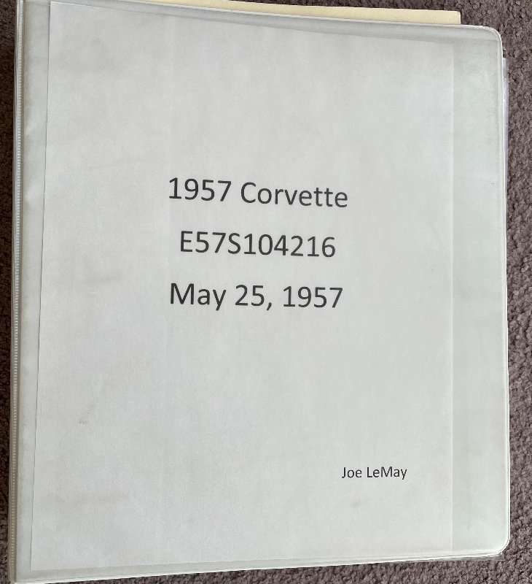
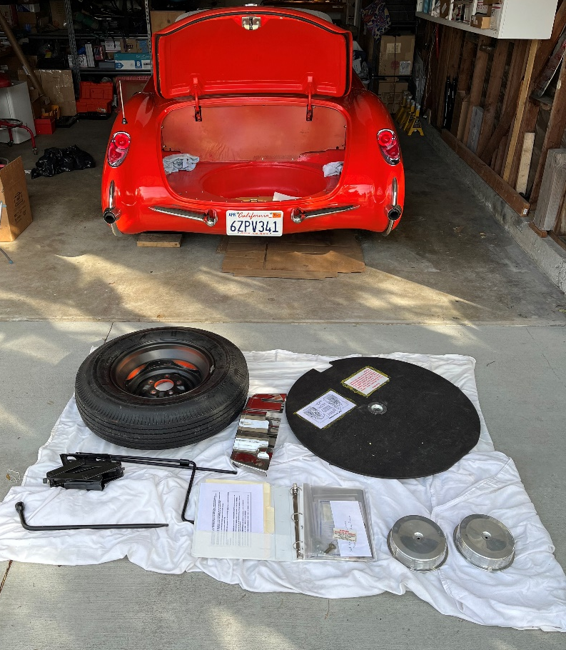
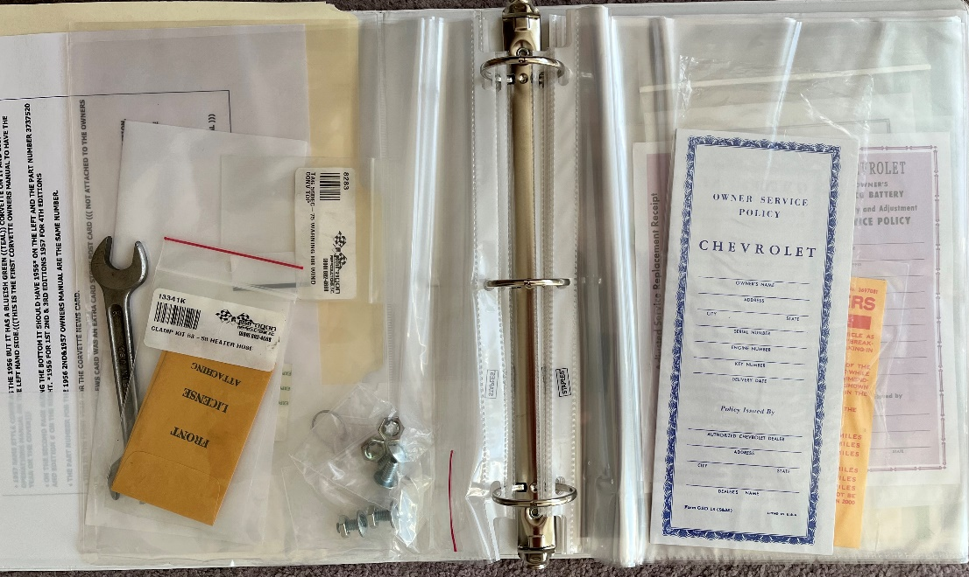
For Owners

Slide 6
JRM 9th Edition
Restore: To Renew; to put back into existence or bring back to a former or original state.
Repainting an original black Corvette with black lacquer paint
Installing accurately reproduced black vinyl seat covers in a car that left the factory with a standard black interior
Stamping a 435-HP block to conform to the date/serial number of the original 435-HP Corvette in which it is to be installed
Counterfeit: To make an imitation of something else with intent to wrongfully deceive or defraud.
Repaint original blue car red and change trim tag to make red appear the original color
Install red interior in a car that left the factory with blue interior and changing trim tag to make red appear to be the original color interior
Replace engine of original small-block Corvette with big block and stamping numbers on it to make it appear to be original big-block engine
Replace carburetor on engine with a fuel-injection unit and stamping numbers and suffix code on the block to make it appear to be original fuel-injection car

Slide 7
Deductions
If no deductions, a slash “/”
Whole numbers
Either 0-points or more
Round up and down
0.1, 0.2, 0.3, 0.4, 0.5: round down to zero
0.6, 0.7, 0.8, 0.9: round up to 1
A brief notation must be made for any deduction.

Slide 8
Dots
Use of Dots is not listed nor required
Not everyone uses them
Decide before if you will be using them
Used where a partial deduction occurred but not enough for a 1-point deduction
Either 0-points or 1-point deducted
When 20% of 1-point = 0.2 points
Put a Dot next to the box
Accumulate Dots until enough for a full point
4-Dots?: you decide

Slide 9
Originality
Does NOT mean a successfully judged part is: the original factory-installed part.
Does IMPLY it appears as though it could be.
Does NOT mean the existing paint is that which was originally applied at the factory.
Does IMPLY it appears as though it could be.

Slide 10
Originality
A component part judged to APPEAR as a complete original part, receives full credit.
Do not judge Condition until completed with Originality.

Slide 11
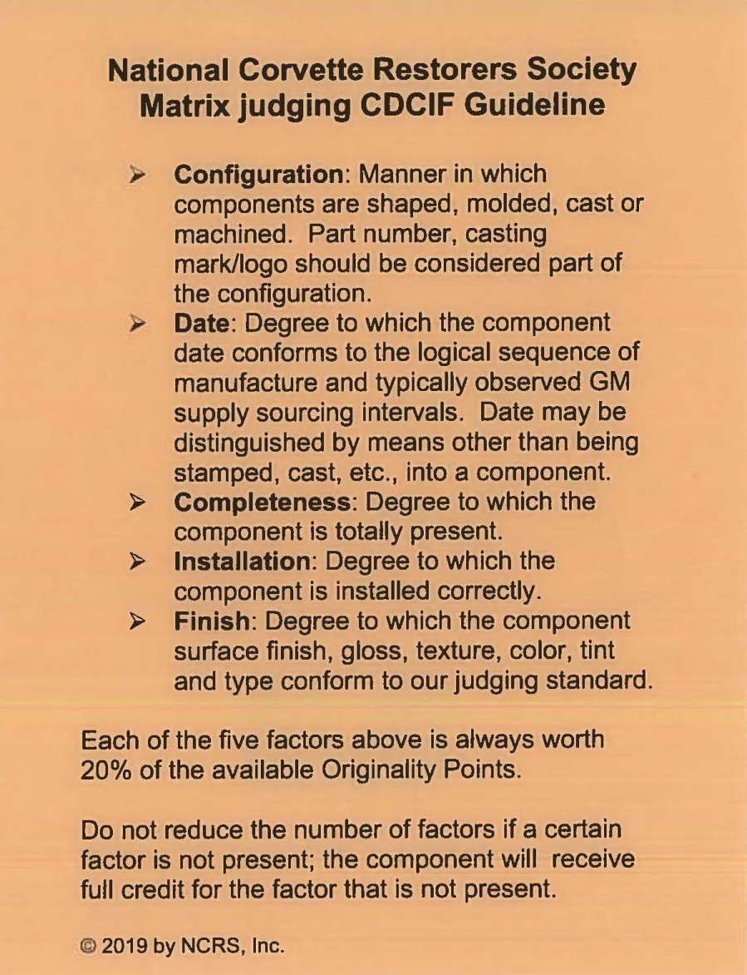
CDCIF
It is (almost) always used to judge Originality
Configuration
Date
Completeness
Installation
Finish

Slide 12
CDCIF
Configuration:
Manner in which components are shaped, molded, cast or machined. Part number, casting mark/logo are part of configuration.
Date:
Degree to which the component date conforms to the logical sequence of manufacture and typically observed GM supply sourcing intervals. Date may be distinguished by means other than stamped, cast, etc., into a component.

Slide 13
CDCIF
Completeness:
Degree to which the component is completely present.
Installation:
Degree to which the component is installed correctly.
Finish:
Degree to which the component surface finish, gloss, texture, color, tint, surface finish and type conform to the judging standard.
Some original finish MUST exist.

Slide 14
CDCIF
Each of the five factors is always worth 20% of the available Originality Points.
Do not reduce the number of factors if a certain factor is not present;
The component will receive full credit for the factor that is not present.
C
D
C
I
F

Slide 15
CDCIF
If the typical finish is Cad plated and the part is painted, it is a 20% deduction.
Example:
One CDCIF non-typical issue.
A ten-point component receives a two-point deduction.
A two-point component cannot receive a one-point deduction.

Slide 16
CDCIF
Originality deductions not made based on:
Item is GM-service replacement;
GM-licensed reproduction; or
Non-OEM component.
Item judged based on overall degree of compliance with CDCIF

Slide 17
Condition
10% Originality Rule.
At least 10% of originality points need to remain to score condition.
Will normally be judged w/o regard to Originality

Slide 18
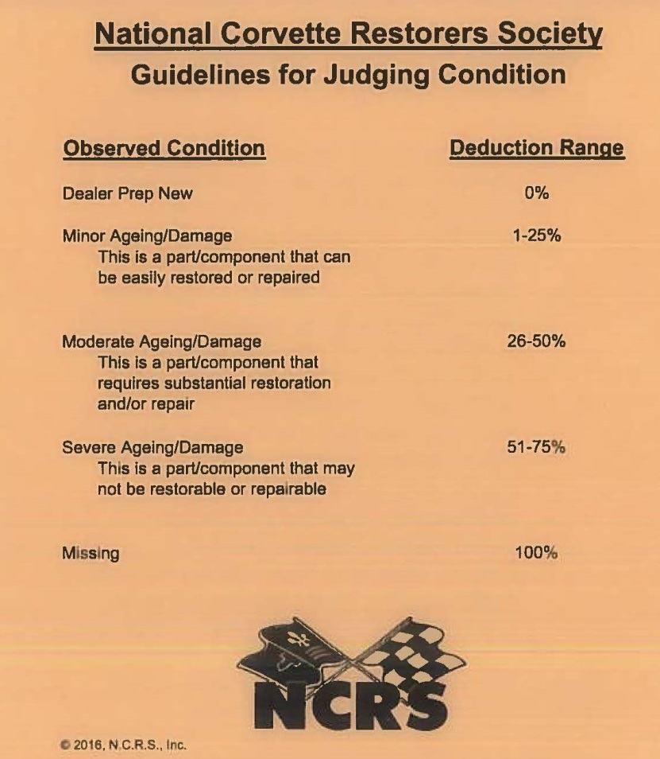
Guidelines for Judging Condition

Slide 19
Guidelines for Judging Condition
Observed Condition Deduction Range
Dealer Prep, New 0%
Minor Ageing/Damage 1-25%
Part/component that can be easily restored or repaired
Moderate Ageing/Damage 26-50%
Part/component that requires substantial restoration and/or repair
Severe Ageing/Damage 51-75%
Part/component that may not be
restorable or repairable
Missing 100%

Slide 20
Guidelines for Judging Condition
Minor ageing/ damage:
Part or component can be easily restored or repaired
1% to 25%
Majority of cars in flight judging would likely fall in this range

Slide 21
Guidelines for Judging Condition
Moderate ageing/ damage:
Part or component requires substantial restoration and/ or repair
26% to 50%

Slide 22
Guidelines for Judging Condition
Severe ageing/ damage:
Part or component may not be restorable or repairable
51% to 75%

Slide 23
Guidelines for Judging Condition
Missing:
100%
Can a part that is present receive 76% to 99% condition deduction?
According to the card…. It would never be appropriate

Slide 24
Guidelines for Judging Condition
What is the condition deduct?
It can be restored. Not more than 50%. Certainly not 75%.

Slide 25
Guidelines for Judging Condition
Cleanliness and Condition are not the same
“If a component can be restored to ‘Dealer Prep Clean’ condition using soap and water or mild solvent, it is DIRTY, not damaged.
Should not receive condition deduction
“Dirty” is not a Condition for an individual item
Shall not be deducted for that item.

Slide 26
Guidelines for Judging Condition
When making notes, think about words like:
Aged −Scuffed − Rusted
Worn − Frayed − Bent
Deteriorated − Split − Dull
Corroded − Cracked − Scratched
Torn − Dented − Chipped
Damaged − Stained − Discolored
Faded − Pitted

Slide 27
Guidelines for Judging Condition
Overall Cleanliness is a 20-point Condition
Shall be determined by how clean or dirty
In each of the four judged sections
Cannot deduct 16 points for a car that is very dirty.
That is greater than 75% of 20 points

Slide 28
Condition: When part of an assembly is missing
Exception: part is unavailable to judge
Partial deduction on originality
Partial deduction on condition
Example: Ten bolts are judged, five are present
Line item is 10 points
Maximum 5 points originality deduction
No more than 5 points condition deduction, if the five are dealer prep, new

Slide 29
Condition: When part of an assembly is missing
Example: One main part with five non-typical bolts (significantly dissimilar). Part is new.
Line item is 10 points. Main part is 8 points.
Maximum 2 points originality deduction.
No more than 2 points condition deduction.

Slide 30
When is CDCIF Not Used
When it is a standard deduction.
Go to the standard deduction sheet (2019)
A part that is present, cannot receive a full deduction
Shocks, transmission, voltage regulator
Unless a Standard Deduction or
Unless Significantly Dissimilar

Slide 31
When is CDCIF Not Used
Items that are Significantly Dissimilar as installed receive Standard Deduction of 100%
Cardboard kick panels
Alternator in place of generator
Holley carb in place of Carter, Rochester, etc.
Edelbrock intake manifold
4-speed in a 1956 or 1957 before VIN 3467
Muncie before the trans was released

Slide 32
Standard Deduction
Tires
Non-DOT: Deduct 10% of originality (5 tires)
2% per tire; total 3 points
4 DOT and one non-DOT spare
Deduct 8%; total 2 points (2.4 point deduction)
Get 1 point back for that non-DOT spare in good condition

Slide 33
Ops vs. PV - as of Feb 2023
NOTICE: An Operations Check is a confirmation of the general functionality of an item or assembly. It differs from the Performance Verification Test, which is a confirmation that an item or assembly functions exactly as designed/ intented/ expected. Because of the difference in the two functionality tests, from time-to-time there will be instances where a particular item that functions exactly the same for both tests, passes the Operations Check, but fails the Performance Verification Test. Please consult your judge and/ or Team Leader if you have a question on a specific Operations Check.

Slide 34
Standard Deduction- as of Feb 2023
Batteries
No Originality Deduction for original or original design reproduction indiscernible as installed Delco as described in the appropriate year TIMJG with, and if applicable, appropriate plant and date stamping for the vehicle. Do not remove caps for inspection.
Table of Originality Deductions:
Deduct 10%: Battery appearing as above but with no appropriate plant or date stamping, if applicable.
Deduct 15%: Reproductions differing from original design and construction in minor detail.
Deduct 25%: Delco, correctly sized service replacement with appropriate top or side post configuration.
Deduct 100%: Originality & Condition for others.

Slide 35
Standard Deduction- as of Feb 2023
Windshields, Door Glass, Roof Panels, Plexiglas & Vinyl Windows
No Originality Deduction: OEM, as described in each appropriate year TIMJG, dated within 12 months prior to vehicle assembly.
Table of Originality Deductions:
Deduct 20%: As above, excepting only the date.
Deduct 25%: OEM brand, later service replacement style with correct tinting if applicable.
Deduct 30%: OEM brand with incorrectly configured tinting.
Deduct 100%: 1953-62 tinted front or side glass; or 1953-96 non-OEM brand replacement(s); or any year added tinting (film, etc.).

Slide 36
Standard Deduction
Two top car:
Judge top that is present
If hard top: soft top must be in the well
50% deduction on hard top
For either, must have wrench

Slide 37
Standard Deduction
Added or Deleted Options
Addition of aftermarket item, component or assembly
Full deduction on operations, originality and condition for every line item affected by owner (or dealer) addition/change.
Example:·aftermarket air conditioning

Slide 38
Standard Deduction
Color
Deduct 20% of originality
Color corresponds. However, color shade is not consistent with color shade applied at factory.
Coves are not correct shade.
Area of coves vs. car= coves about ½ of car side, sides are about ½ of car. 85 X 20% X ½ X ½ = 4 points
Orig 85, Cond none

Slide 39
Standard Deduction
Body Fiberglass and Component Fit
Deduct 5% of originality
For each body panel, up to a maximum of 4 panels
With atypical color of bare fiberglass and/or
Atypical finish of fiberglass panel(s) that should be unpainted (bare).
Bare fiberglass is addressed in this line item
Orig 60, Cond 60

Slide 40
Body Paint
Gloss
Amount of light reflected from a surface
Distinctiveness of Image (DOI)
Sharpness of a reflected image.

Slide 41
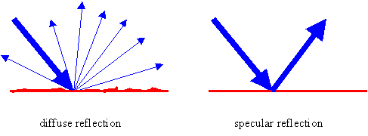
Paint
Gloss
Amount of light reflected from a surface
Determines how shiny a surface appears.
Entering light is one single value,
High Gloss- exiting light is the same value

Slide 42
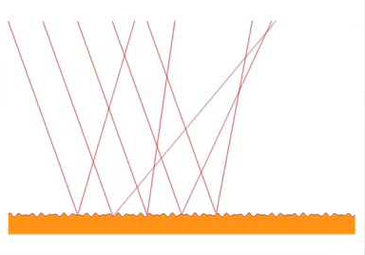
Paint
Distinctiveness of Image (DOI)
Sharpness of a reflected image.
When a reflected object is viewed, the image becomes fuzzy and distorted.

Slide 43
Paint
Distinctiveness of Image (DOI)
When a reflected object is viewed, the image becomes fuzzy and distorted.

Slide 44
Paint
Distinctiveness of Image (DOI)
A highly textured dimpled appearance known as "orange peel".
When a reflected object is viewed, the image becomes fuzzy and distorted.

Slide 45
Paint
Distinctiveness of Image (DOI)
View at 60 degree angle.

Slide 46
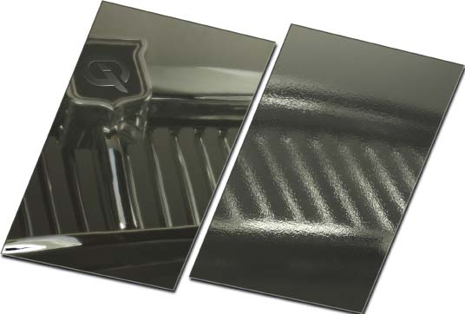
Paint
Distinctiveness of Image (DOI)
High DOI Low DOI
Same glossy level

Slide 47
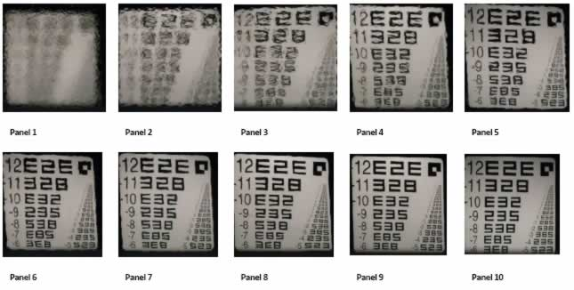
Paint
Distinctiveness of Image (DOI)
Similar coatings may have identical gloss Visually the quality may be very different.

Slide 48
Paint Guidelines
“Factory Applied Material”
Distinctness of Image (DOI)
No buildup on surface edges
“Factory Application Method”
Several criteria to follow

Slide 49
Paint Guidelines “Factory Applied Material”
Distinctness of Image (DOI)
DOI for a factory lacquer finish will have a ‘mid’ level sharpness of reflected shapes (5-6)
Appears to be a “Factory Applied Material.”
Gloss/ Reflectivity is not related to DOI
A shiny finish may have an acceptable DOI

Slide 50
Paint Guidelines
Buildup on Surface Edges
(Doors, hood, trunk, gas door) edges
Factory lacquer was designed to be thermoset at 250F. It was baked.
The paint flowed to a smooth finish and height, and then hardened.
There would be no edge buildup

Slide 51
Paint Guidelines
Paint Guidelines “Factory Applied Material”
Buildup on Surface Edges
(Doors, hood, trunk, gas door) edges
Edges will show no bump or high spots
Buildup does not appears to be typical of a “Factory Applied Material.”

Slide 52
Paint Guidelines
Paint Guidelines “Factory Application Methods”
Appearance consistent with:
Lower coverage on bottom of panels
Lower or incomplete coverage on bottom panel edges
Lower gloss/ reflectivity below the beltline
Lower gloss and DOI inside doors
Hood stripe with defined edge (1967)

Slide 53
Paint Flowchart Guidelines

Slide 54
Paint Flowchart Guidelines
Follow the Flow Chart
1st: Appear to be Factory Applied Material
Yes or No
2nd: Appearance consistent with Factory Application Method
Yes or No
Doors, Hood, Trunk are CLOSED

Slide 55
Paint Flowchart Guidelines
Process
1st: Appear to be Factory Applied Material
Check for DOI in mid level,
and lack of buildup
2nd: Appearance consistent with Factory Application Method
Incomplete or lower coverage, gloss, reflectivity in lower parts of panels
No paint on weatherstrip or trim
Doors, Hood, Trunk are CLOSED

Slide 56
Paint Flowchart Guidelines
Process
1st: Appear to be Factory Applied Material
No
2nd: Appearance consistent with Factory Application Method
No
Doors, Hood, Trunk are CLOSED

Slide 57
Paint Flowchart Guidelines
1st: Appear to be Factory Applied Material
No
2nd: Appearance consistent with Factory Application Method
No
3rd: Now open the doors, hood, and trunk.
Is the appearance of the door jambs, hood ledge, trunk area consistent with factory application methods? Observe door jambs, hood ledge, trunk area-
No: 100% deduction
Or 45, Cd 40

Slide 58
Paint Flowchart Guidelines
0% deduction:
Paint is original factory-applied finish or appears to have been refinished with appropriate factory-applied material and appears consistent with factory application methods.
2nd: Appearance consistent with Factory Application Method
No
Or 45, Cd 40

Slide 59
Paint Flowchart Guidelines
20% deduction:
A. Paint appears to have been refinished with appropriate factory-applied material; however, degree of coverage is inconsistent with factory application methods. Paint is evident on weatherstrip or trim, which was applied after the factory-applied paint.
B. Over/Under Restoration. Factory applied paint typically has evidence of orange peel or overspray in areas typical for that year of application.
Or 45, Cd 40

Slide 60
Paint Flowchart Guidelines
30% deduction:
Paint appears to have been refinished with material not consistent with factory material, but appearance exhibits attributes consistent with factory material and appearance is consistent with factory application methods.
Or 45, Cd 40

Slide 61
Paint Flowchart Guidelines
70% deduction: Open the doors
Paint appears to have been refinished with a material not consistent with factory material, and appearance does not exhibit attributes consistent with factory material, but is consistent with factory application methods.
Or 45, Cd 40

Slide 62
Paint Flowchart Guidelines
100% deduction: Open the doors
Paint appears to have been refinished with a material not consistent with factory material, and appearance does not exhibit attributes consistent with factory material, and appearance is not consistent with factory application methods.
Presence of ANY custom paint modifications including lettering, pin striping, race car numbers or stripes.
Or 45, Cd 40

Slide 63
Guidelines for Judging
Obtain information from the owner
Owned the car for how long
Had the car judged before
Our job is to help the owner
We need to assist the owner. Have the attitude to:
Give points, don’t take away points.
Be a resource for help

Slide 64
Guidelines for Judging
If something is not looked at, it cannot be judged.
It cannot be deducted.
Rear carrier date, bellhousing date
If owner will not provide access to a component, it is a deduction (remove ash tray)
No Magnets:
Observe the finish and determine whether it is stainless steel

Slide 65
Guidelines for Judging
Comments must be included for any deduction
Add comments when there is an issue but it did not meet the criteria to deduct a point.
Word choices are important
Do Not Use: Wrong, Bad, Incorrect
“Finish” does not describe the issue
F: snb paint- does describe the issue
Use: typical, not typical, should be, should not be, see JM page 11,

Slide 66
Guidelines for Judging
For multiple components, determine how much each element is worth
Bumper, brackets, fasteners
How much value are the fasteners?
Judges might choose to allow safety items
Harmonic balancer bolt
Axle U-bolt lockwashers
Fuses

Slide 67
Abbreviations
TFP = Typical Factory Production
NTFP = NOT Typical Factory Production
TYP: Typical
NTP: Not Typical
SB: Should be
SNB: Should not be
D/S: Driver Side
P/S: Passenger Side
SR: Service Replacement
STD DED: Standard Deduction
WRA: Wear, Rust, Age
C: Configuration
D: Date
Cp: Completeness
I: Installation
F: Finish
CN: Condition

